Slide 1
Online Car Reservation using Oracle 10g
น.ส.ณัฐวรรณ เทียมธรรมวงษ์ 45010247
น.ส.พิมลมาศ พรชัยสกุลดี 45010541
นายสุทธิกร แสงรุ่งเรืองศรี 45010851
อาจารย์ที่ปรึกษา รศ.ดร.ศุภมิตร จิตตะยโศธร

Slide 2


Agenda
Objective
Project Scope
Oracle Best Practice
  J2EE Architecture
  MVC Design Pattern
  Multi-tier Architecture
System Development Life Cycle
Further Development
Conclusion

Slide 3
Objectives
Learning Java 2 Enterprise Edition’s Architecture and how to apply in Application Development.
Learning Oracle’s Technologies and their Best Practice as the new Application Development Approach.
Design and Develop ease-of-maintenance Application using Oracle’s Approach and Standard Approach.

Slide 4
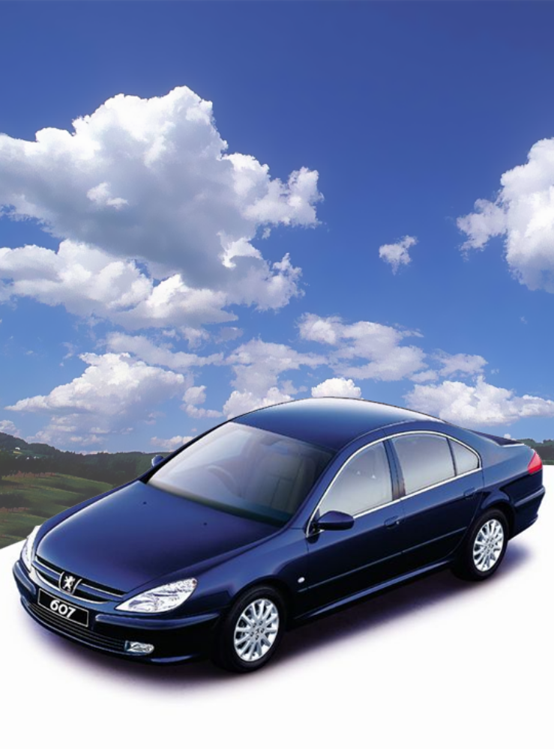
Project Scope
Online Car Reservation System
Deploy as Multi-tier Application
Ease-of-use and maintenance
Portability
Compatibility with Exist System

Slide 5
Oracle Best Practice
Oracle Best Practice for Application Development
  Develop Application using Java 2 Enterprise Edition
  Develop Application using Model-View-Controller (MVC) Design Pattern
  Deploy Application using Multi-tier Architecture

Slide 6

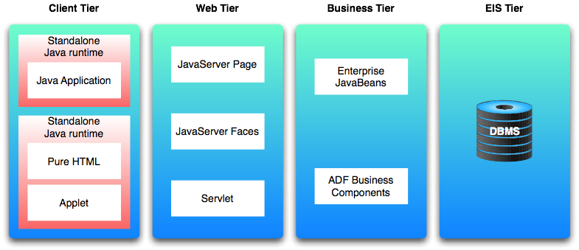

Oracle J2EE Architecture
Online Car Reservation System using Oracle JDeveloper 10g

Slide 7
MVC Design Pattern
View
Handles the application’s user interface
Controller
Handles application flow and acts as interface between the Model and View Layers
Model
Handles interaction with data source and also runs business logic as well
Online Car Reservation System using Oracle JDeveloper 10g

Slide 8
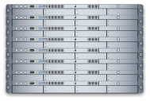

Multi-tier Architecture
Client-tier
Application Server-tier
Database-tier
2-tier
3-tier
Online Car Reservation System using Oracle JDeveloper 10g

Slide 9

System Development Life Cycle
}
System Planning
System Analysis
System Design
System Implementation
System Operation, Support and Security
CASE STUDY

Slide 10

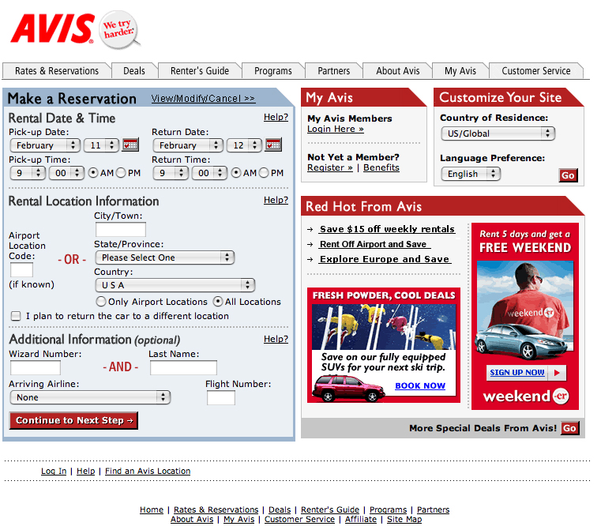
System Planning
Perform Preliminary Investigation from case study: www.avis.com
  Feature
  Process
  Technology
Make Conclusion Report
Online Car Reservation System using Oracle JDeveloper 10g

Slide 11
Case Study
Car Reservation Process
Member Registration & Login
  Member Information
  Rapid Rental Information
  Rental History
Renter’s Guide
News Letter Subscription
Customer Services
  Accidental Report Form
  Comments/Feed Back
  Request Past Reservation Agreement

Slide 12
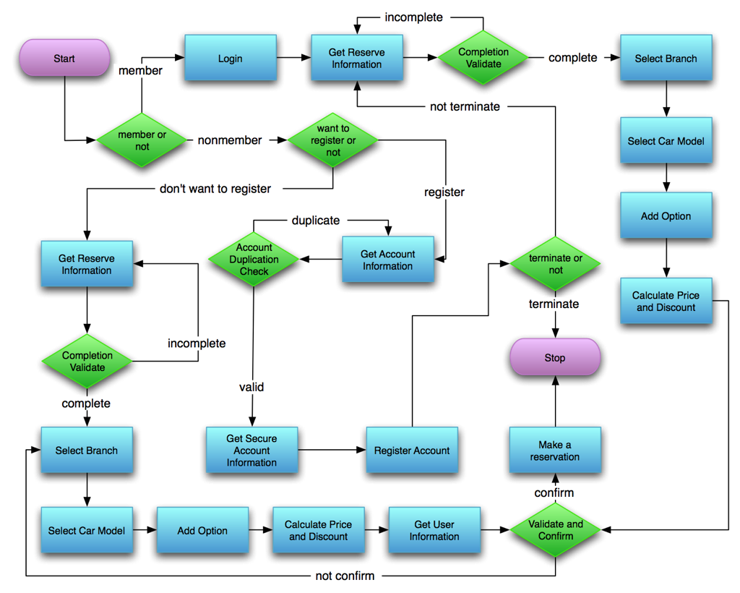
AVIS’s Reservation Process Flow Chart

Slide 13
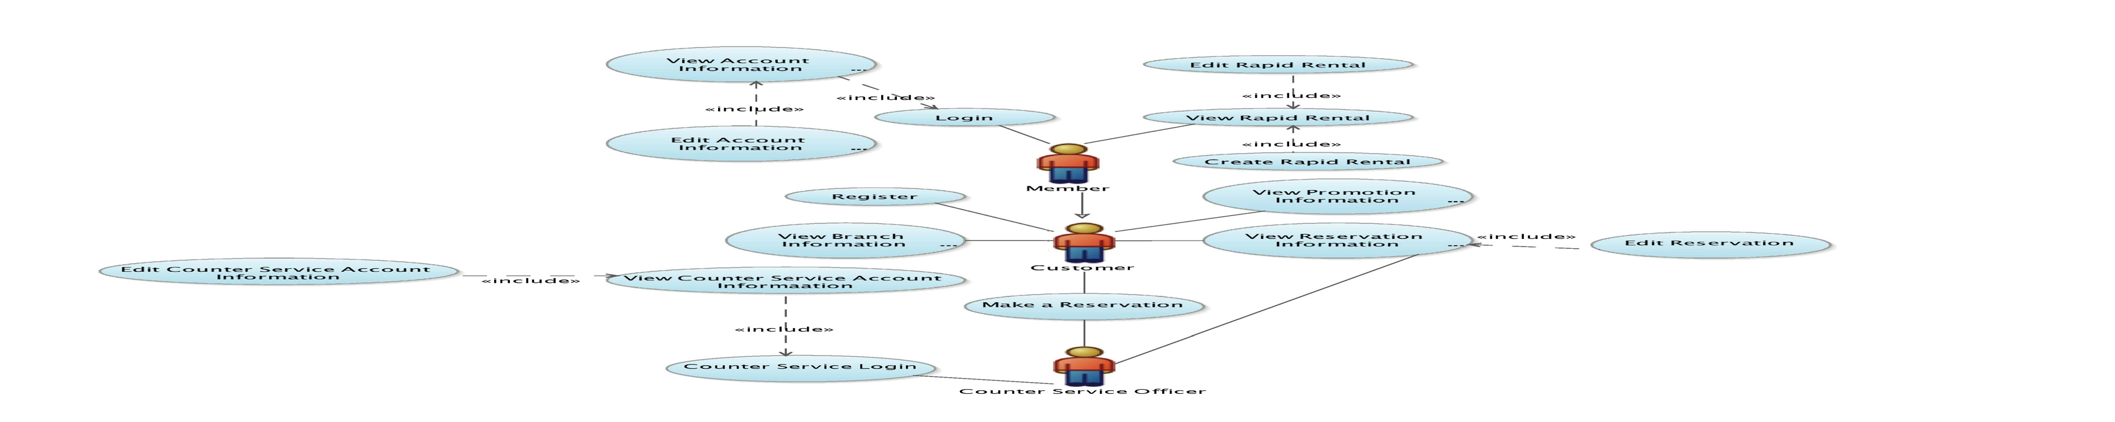
System Analysis
Requirement Model
  Use Case Diagram
Requirement Checklist
  Input/Output
  Process
  Performance/Control
Online Car Reservation System using Oracle JDeveloper 10g

Slide 14
Use Case Diagram

Slide 15
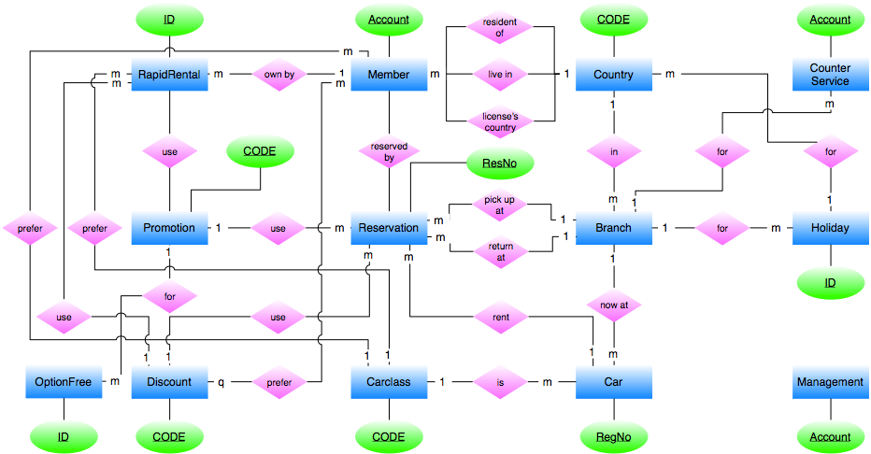
System Design
Input/Output and User Interface Design
Data Design
  Entity Relationship Diagram
  Database Diagram
System Architecture Design
Online Car Reservation System using Oracle JDeveloper 10g

Slide 16
Entity Relationship Diagram

Slide 17
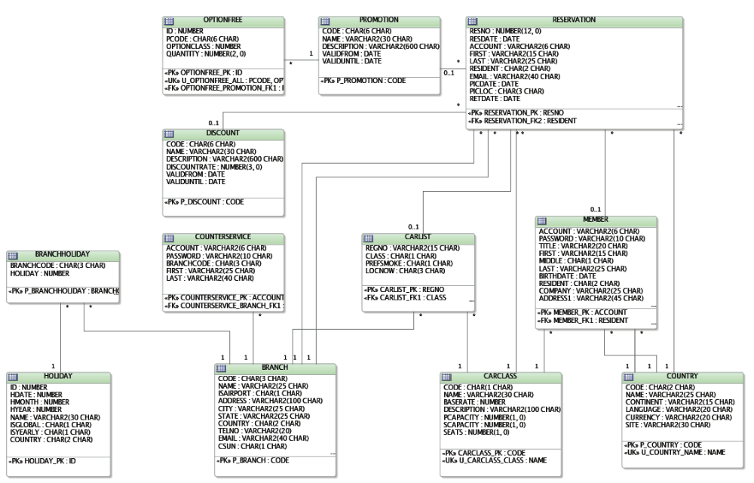
Database Diagram

Slide 18
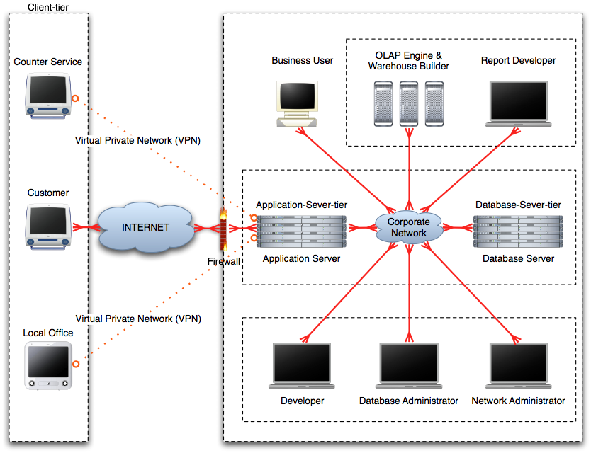
System Architecture Design

Slide 19
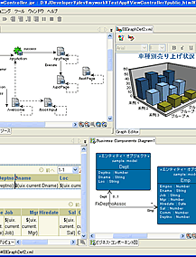
System Implementation
Application Development using JDeveloper 10g R3 based on Oracle ADF.
Oracle ADF is the J2EE Application Development Framework based on MVC Design Pattern.
  Provide Multi-Technology Support for each Layer and Platform Independence.
  Flexible deployment technology without changing code and Ease-of-maintenance.
Online Car Reservation System using Oracle JDeveloper 10g

Slide 20

Oracle ADF Architecture
View
Layer
ADF Faces
JSF
JSP
JavaServer Face (JSF)
Controller
Layer
Faces Controller
Servlet
Oracle JDeveloper 10g
Model
Layer
ADF Controller
ADF Model (data binding & data control)
Business Service
ADF Business Components
EJB/TopLink
Web Services/XML
Java Beans/JDBC/Others
Online Car Reservation System using Oracle JDeveloper 10g

Slide 21
Application
Car Reservation Application for Customer
Counter Service Application for Counter Service Officer
Back Office Application for Management Officer

Slide 22
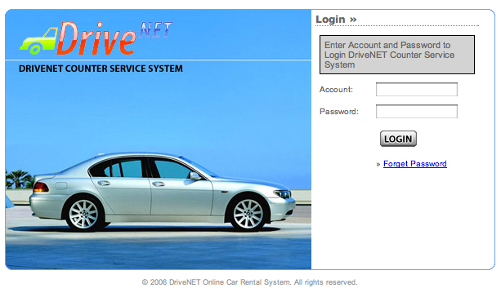
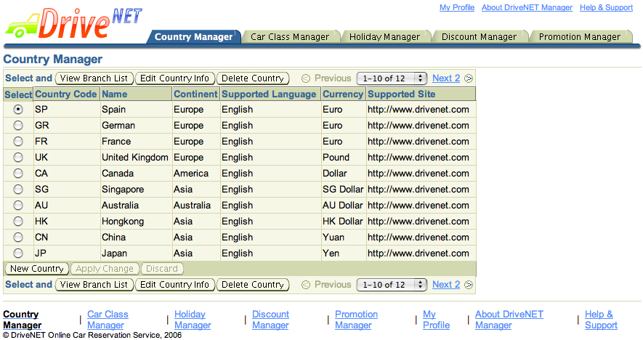
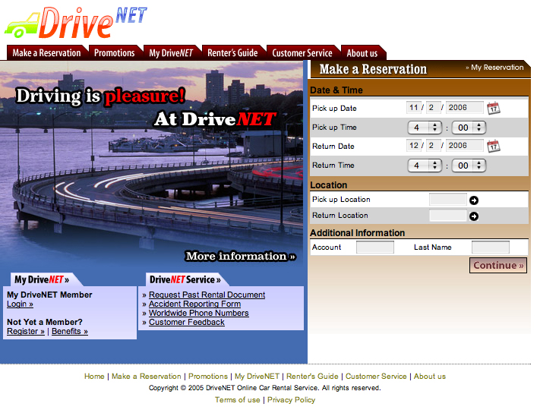
Application
Online Car Reservation System using Oracle JDeveloper 10g

Slide 23
ADF Faces Development
Database Modeling using Database Diagram
Page Flow Modeling using Page Flow Diagram (face-config.xml)
Build Data Model using Business Component Diagram
  Add Business Rule and Validation
Build User Interface using ADF Faces

Slide 24

JSP Development
Develop Infrastructure Class
Develop Entity Class for Model Layer
Develop Backing Beans for Controller Layer
Design & Develop User Interface using JavaServer Page and HTML for View Layer
Develop User Interface Components for User Interface enhancement

Slide 25

System Operation
Deploy as Multi-tier Application using following configuration
  Database-tier: Oracle Database Server 10g Release 2
  Application-Server-tier: Oracle Application Server 10g Release 3
    Oracle Application Server 10g Container for J2EE
    Oracle Application Server Web Cache (Optional)
Online Car Reservation System using Oracle JDeveloper 10g

Slide 26
Conclusions
 | ADF Faces | JSP
Advantage | Provide pre-designed various User Interface Components. ADF Engine handle any Data Source in Model Layer. ADF Engine handle Controller Layer by Page Flow Diagram. Support number of Technologies in each Layer. Well organized Code. | Support any Vendor’s Product. There’s a lot of documents and knowledge base over internet. Flexible and Ease-of-User Interface Design.
Disadvantage | Lack of User Interface Customization. Work well with Oracle Platform. Lack of Documents and Knowledge Base | Manually Develop User Interface Components. Manually Coding may cause somewhat messy code. Much more steps in Development.

Slide 27
Experiences
Unstable Release of Development Tools.
Lack of Documentation.
Highly Hardware Specification Requirement to run Development and Deployment Tools.
Compatibility Problems, because ADF Faces is a Brand-new Technology and still not supported by other vendors Product.

Slide 28
System Requirement
Application Server 10g
  RAM: at least 1 GB
  Disk Space: 494 MB~2.5 GB
  depend on modules
JDeveloper 10g
  CPU Speed: 2 GHz or faster
  RAM: 2 GB
Database Server 10g
  RAM: at least 512 MB
  Virtual Memory: Double the amount of RAM

Slide 29
Q&A

